Slide 1

Agents with Code Execution
Conversation Agents: Part 1
Apoorv Vishnoi
Head of Training, Analytics Vidhya
Notes:
In the last lesson, we built a personalized newsletter for an organization using a sequential conversation pattern powered by tools. In this lesson, we will enhance our agents further. LLMs can write code to analyze data or generate charts, but they can't execute it. Agents with code execution bridge this gap.

Slide 2
Agents with Code Execution
User Proxy Agent
Code Reviewer
Agent
Initial Message
Chat
Result
Summarizer
Carryover
Carryover
Code
Writer Agent
Code Executor
Agent
Notes:
In AutoGen, the code drafting process can be a sequential conversation between a user proxy agent, code writer agent, a code executor, and a code reviewer agent.

Slide 3

Agents with Code Execution
Notes:
The key argument in Autogen to enable the code execution functionality for an agent is “code_execution_config=True”

Slide 4

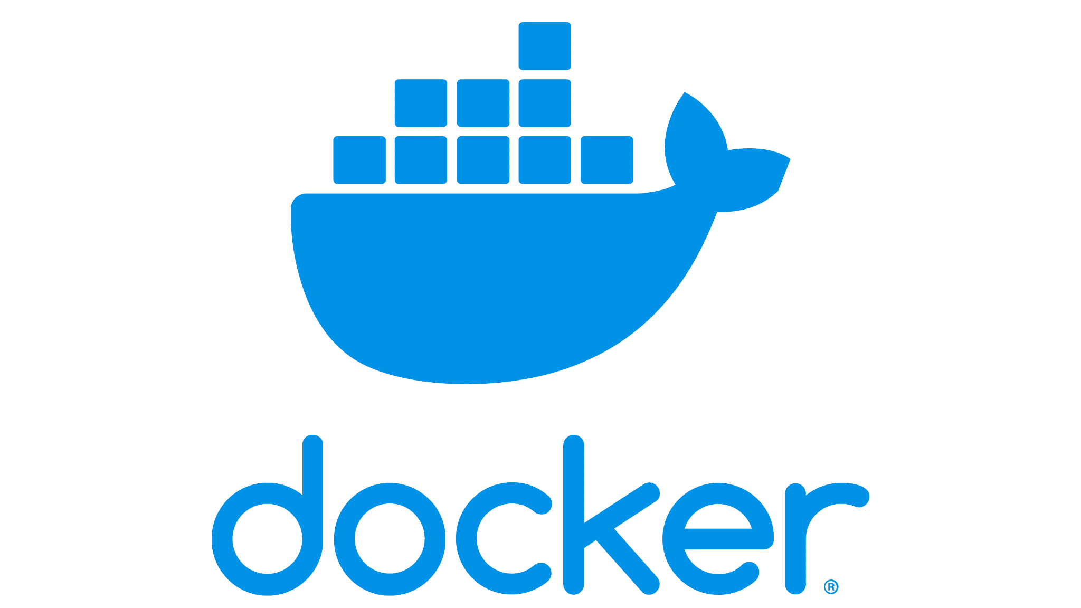
Code Agent Execution Styles
Ways to Execute Code by Code Agent
Executed Locally
Docker Container
Notes:
Now within the code executor agent, the code can be executed either locally, i.e., within the same system on which Autogen is installed, or using a docker container that runs code in a separate, isolated environment.

Slide 5
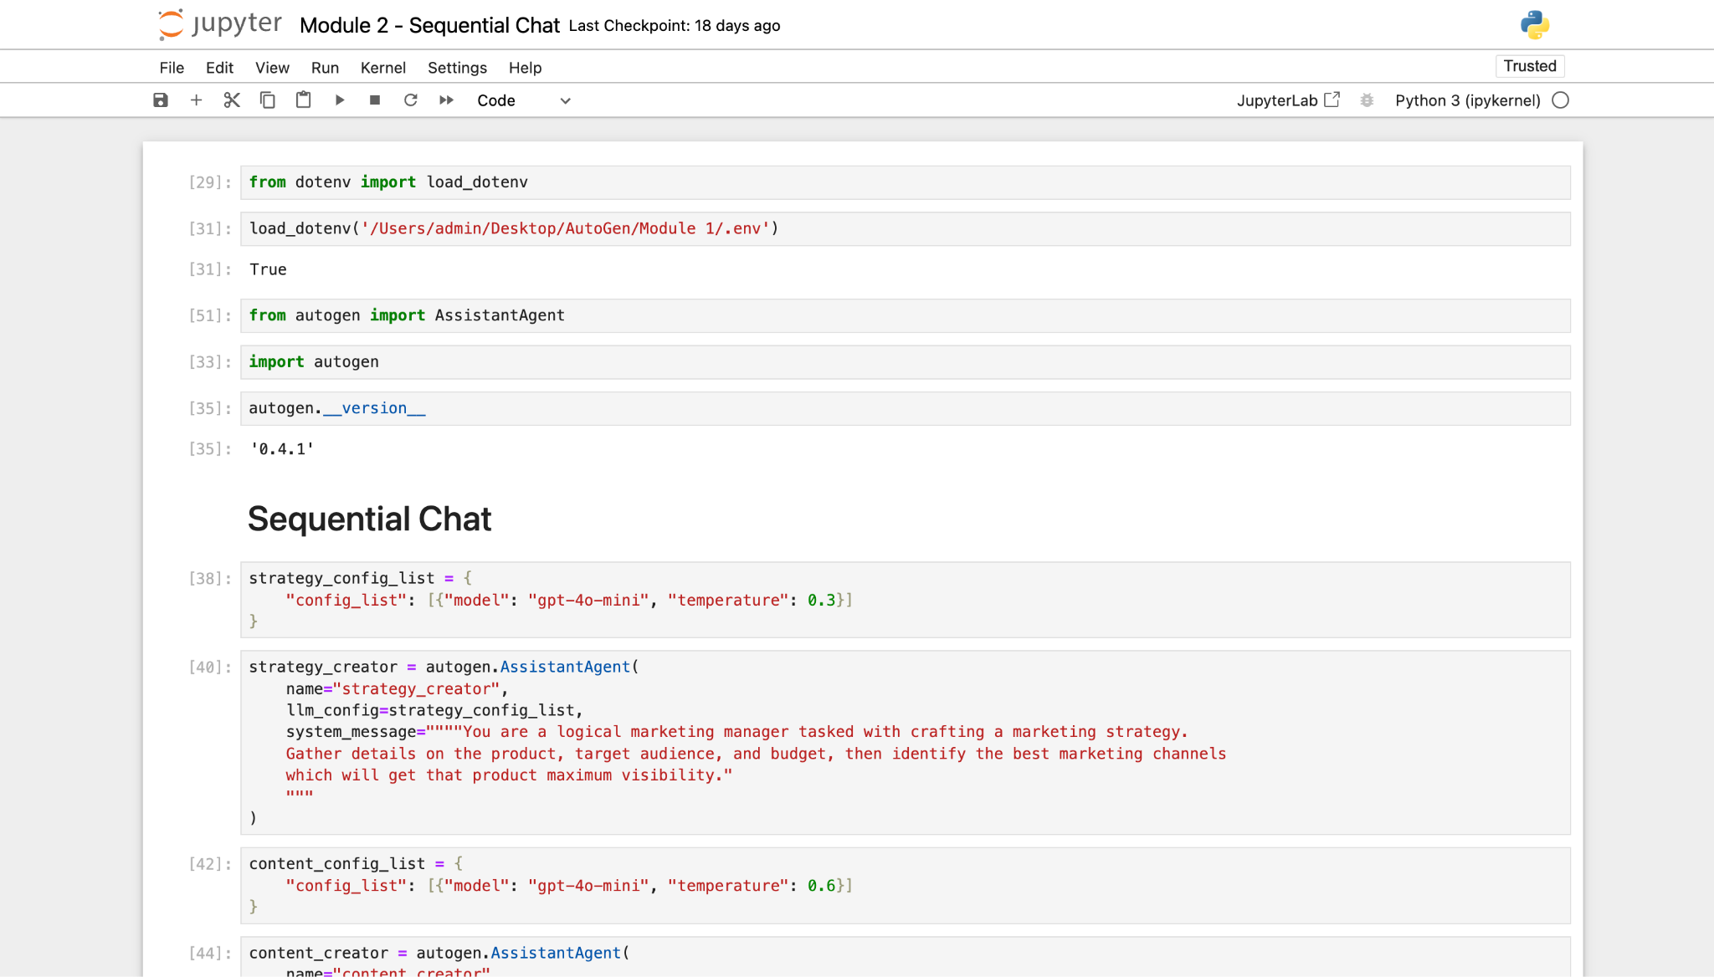
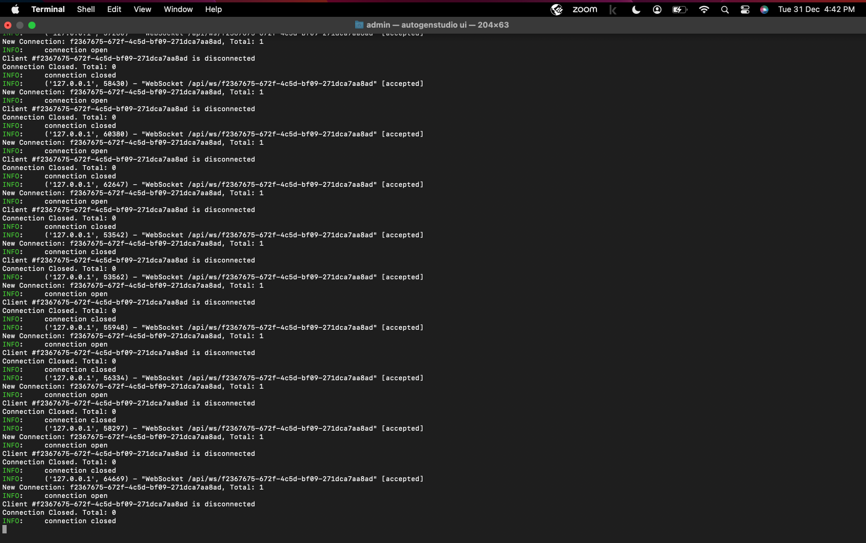

Code Agent Execution Styles
Executed Locally
Notes:
Further, if you are using local execution Autogen you have the choice to execute your code in Command line or Jupyter. Let’s move to Jupyter notebook and build a software development agentic system leveraging the code execution capabilities.

Slide 6
Jupyter Notebook

